Slide 1
Restaurant Sales Forecast
May 5th, 2017
Werner Chao
Harriet Huang

Slide 2
Outline
Data Cleaning
Data Exploratory
Time Series Model
Statistical Testing
ACF/PACF plots
Model Building
Forecasting
Tree Based Model
Tree Algorithm Review
Feature Engineering
Parameter Tuning
Forecast

Slide 3
Outline
Data Cleaning
Data Exploratory
Time Series Model
Statistical Testing
ACF/PACF plots
Model Building
Forecasting
Tree Based Model
Tree Algorithm Review
Feature Engineering
Parameter Tuning
Forecast

Slide 4
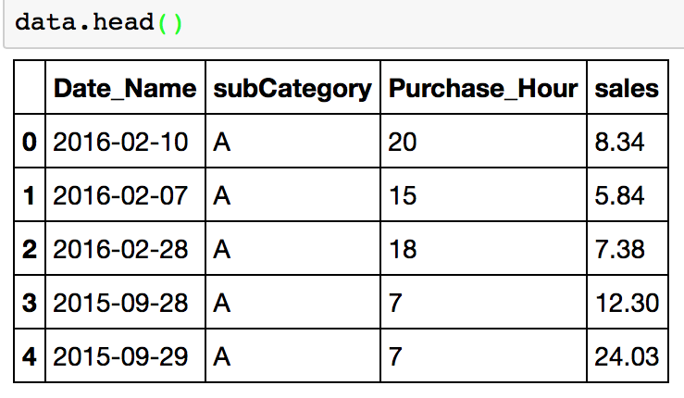
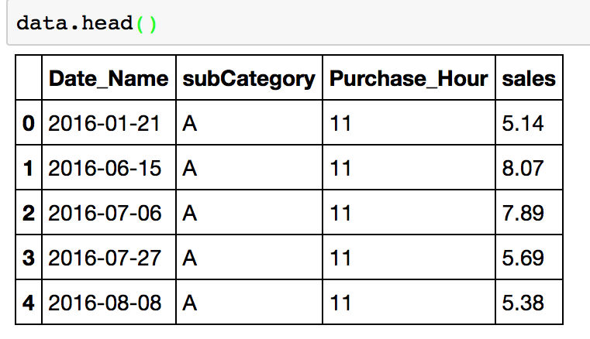
Data
2 Restaurant
3 Features
Need to predict: Sales
Restaurant A
Restaurant B

Slide 5
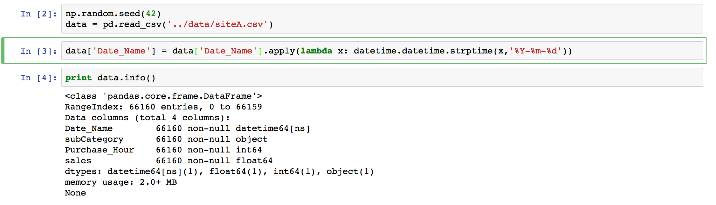
Data Cleaning
Format 'date' column to proper format¶

Slide 6
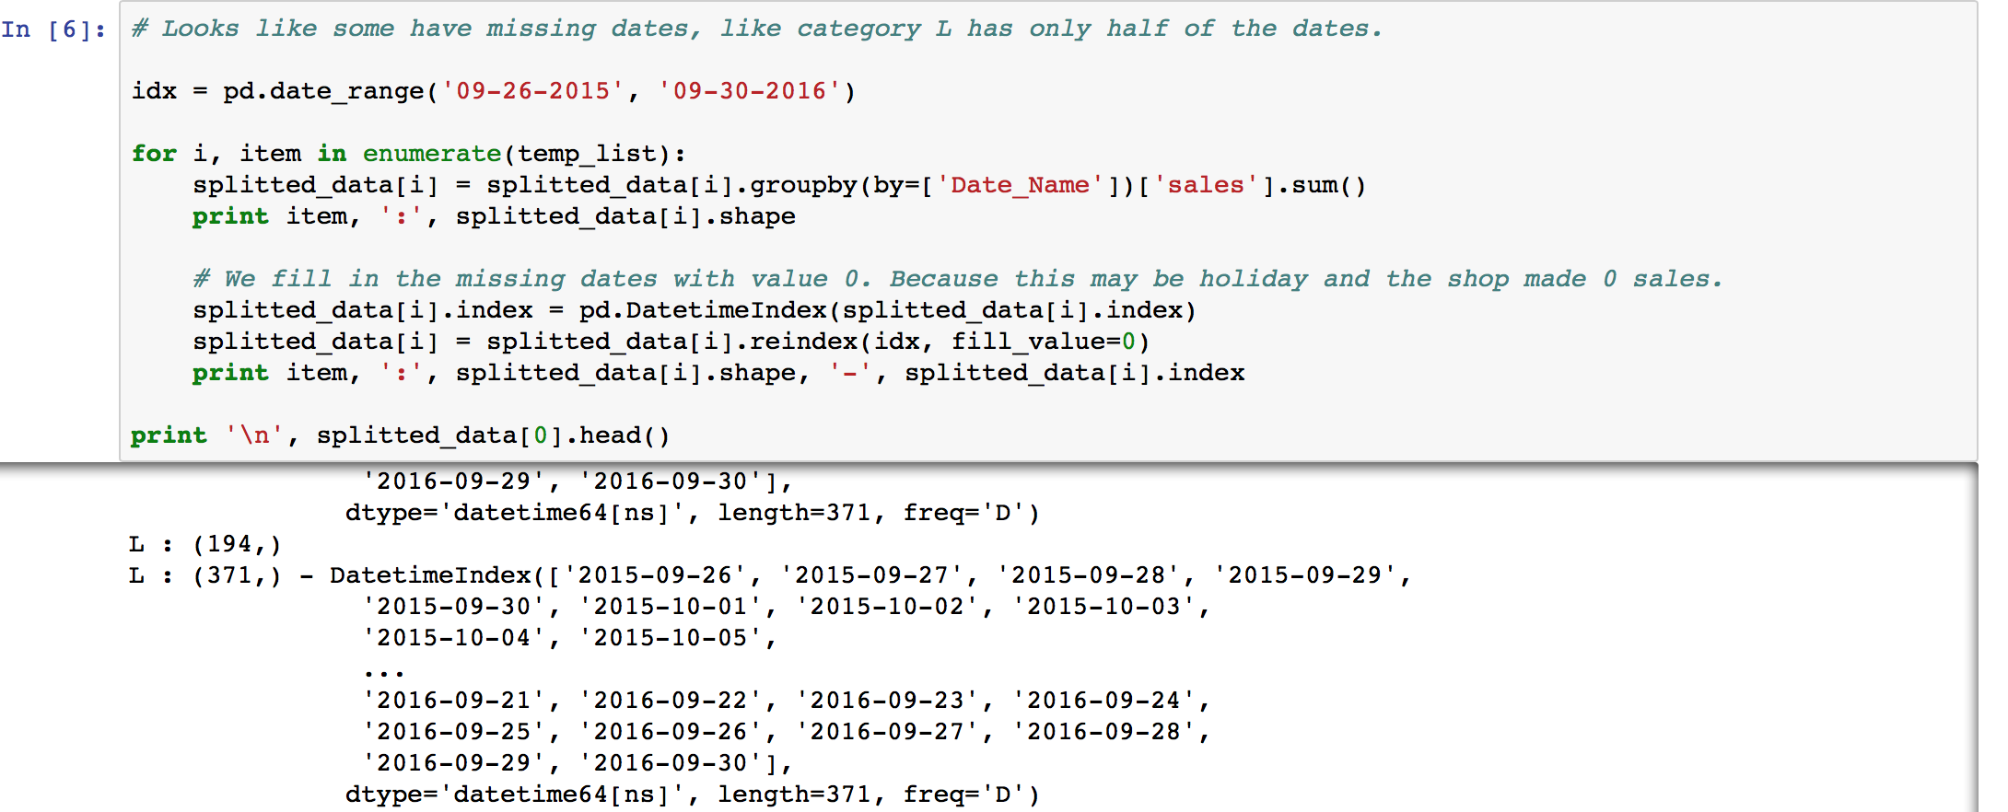
Data Cleaning
Fill in missing dates, i.e. category L only has half of the dates¶
Fill the missing sales values with 0 - assume 0 sales for that day due to holiday

Slide 7
Outline
Data Cleaning
Data Exploratory
Time Series Model
Statistical Testing
ACF/PACF plots
Model Building
Forecasting
Tree Based Model
Tree Algorithm Review
Feature Engineering
Parameter Tuning
Forecast

Slide 8
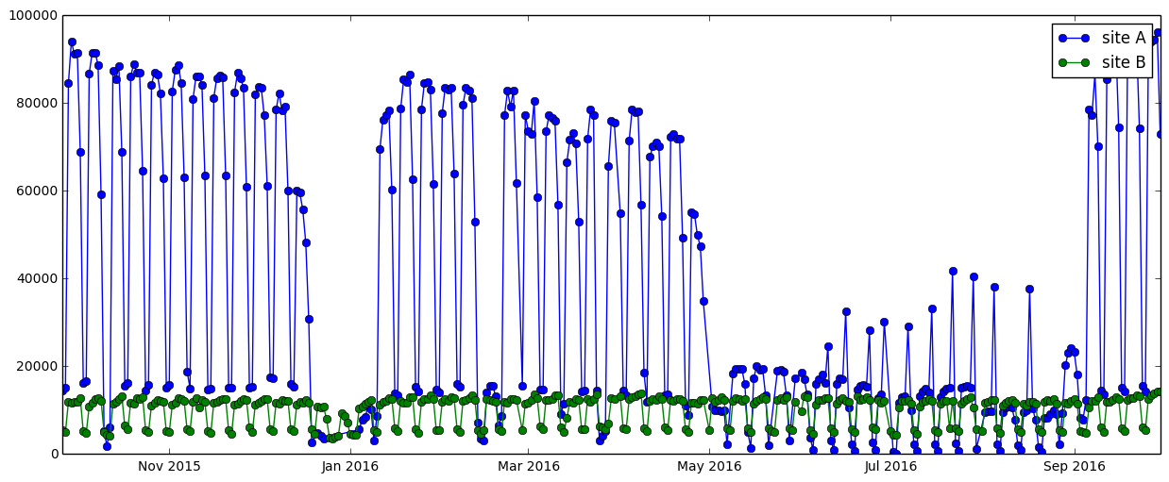
Data Exploratory – Both Sites
Site A has a lot of variations; site B is fairly stationary
X’mas no sales
Summer low volume
Some spikes

Slide 9
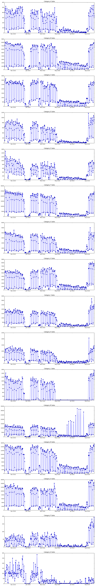
Data Exploratory (Site A) – Q
Q: lots of variances, doesn’t follow the overall curve dynamics

Slide 10
Data Exploratory (Site A) – L & M
L: zero sales during the summer
M: some spikes, promotional events?

Slide 11
Data Exploratory – Both Sites
Focus on Site A. More difficult case.
X’mas no sales
Summer low volume
Some spikes

Slide 12
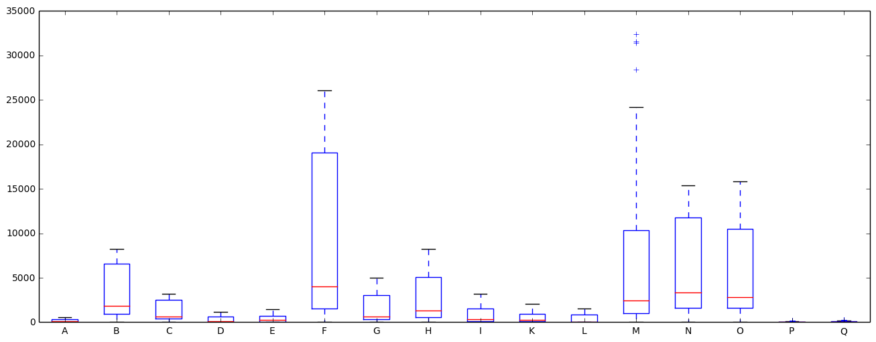
Data Exploratory (Site A) – Box Plot
Boxplots tell us:
50% of the observations are below a small dollar value
75% of the observations are below a large dollar value
Large value span from 50%~75% percentile

Slide 13
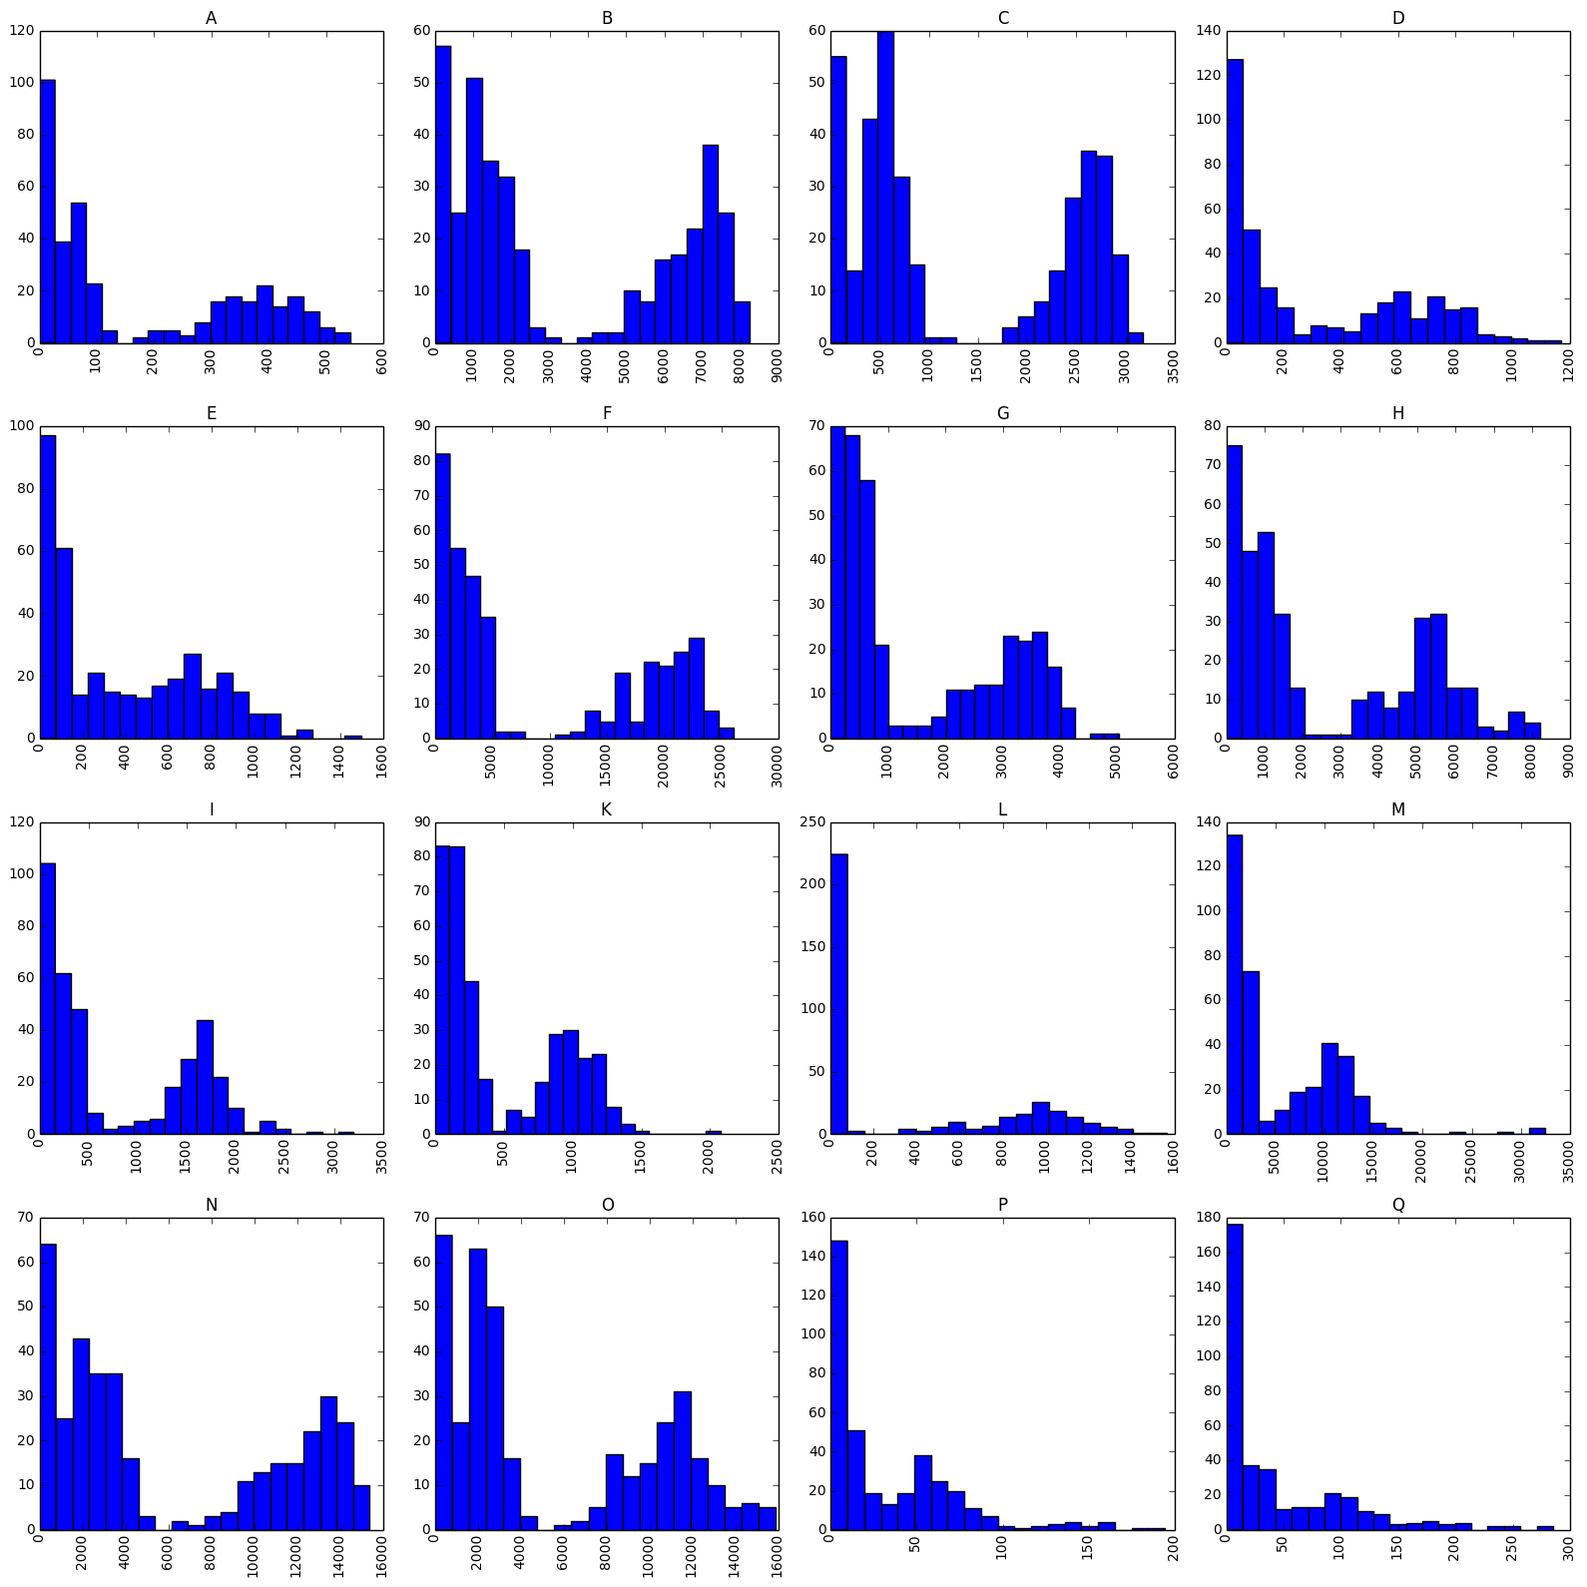
Data Exploratory (Site A) - Histograms
2 distributions (mixed Gaussian):
Non-summer weekdays
Non-summer weekends + summer sales
Very few counts in between the groups

Slide 14
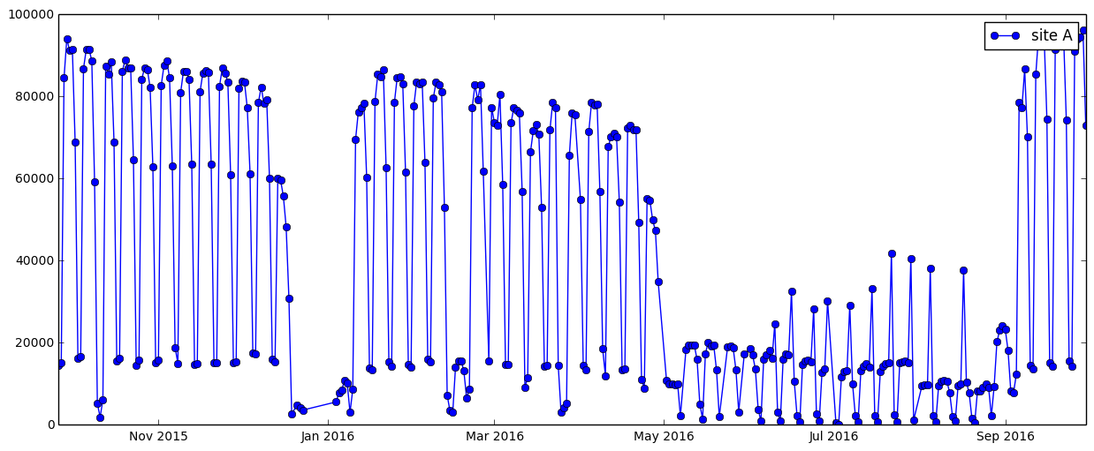
Two Distributions

Slide 15
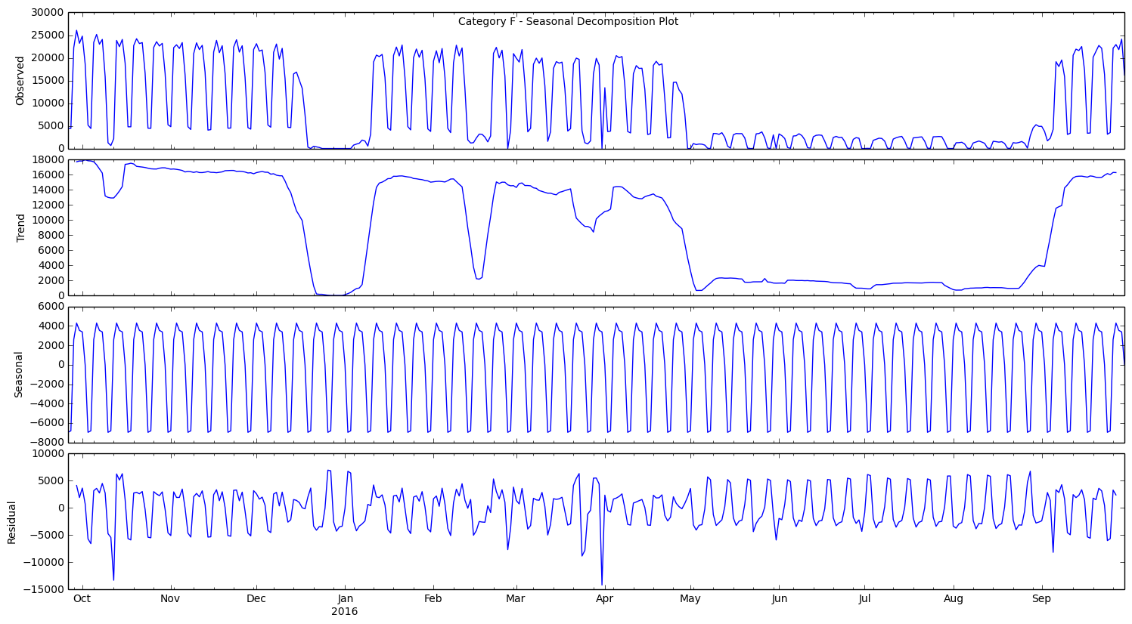
Data Exploratory (Site A) – Seasonal Decomposition Plot
Not an obvious trend; downwards trend in each quarter
Confirm the weekly seasonal behavior
Residual plots too regular; non-stationary

Slide 16
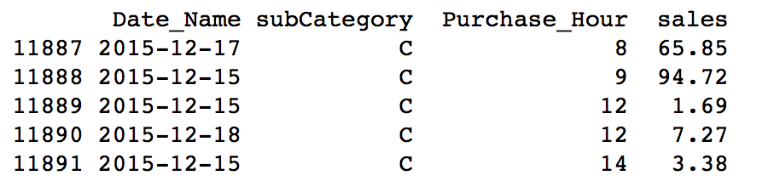
Data Exploration – Time Series Model
We have a time series data set
3 features; 2 are time based feature
Most common AR, MA, or Seasonal ARIMA models
Tree based models

Slide 17
Outline
Data Cleaning
Data Exploratory
Time Series Model
Statistical Testing
ACF/PACF plots
Model Building
Forecasting
Tree Based Model
Tree Algorithm Review
Feature Engineering
Parameter Tuning
Forecast

Slide 18
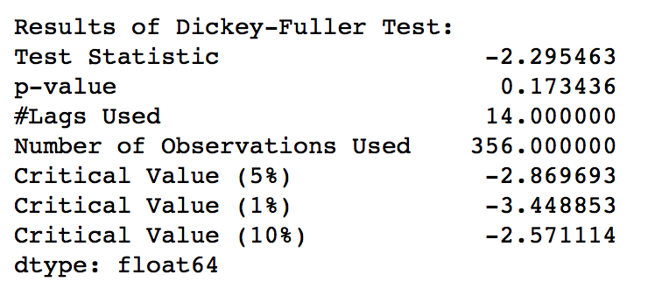
Statistical Testing – Dickey-Fuller Test

Slide 19
Statistical Testing - Transformations
Seasonal(obs) – shift by 7 days
Seasonal(Inversed( )) – inverse hyperbolic sine
Seasonal(Diff())
Seasonal(Diff(Inversed( )))

Slide 20
Statistical Testing - Transformations
 | Raw | Sea() | Sea(Inv) | Sea(Diff) | Sea(Diff(Inv))
5% Confidence Interval | -2.87 | -2.87 | -2.87 | -2.87 | -2.87
Test Statistic | -2.29 | -4.42 | -4.71 | -7.84 | -7.47
Pass the Test? | Fail | Pass | Pass | Pass | Pass

Slide 21
Outline
Data Cleaning
Data Exploratory
Time Series Model
Statistical Testing
ACF/PACF plots
Model Building
Forecasting
Tree Based Model
Tree Algorithm Review
Feature Engineering
Parameter Tuning
Forecast

Slide 22
Statistical Testing – ACF/PACF Plots
ACF/PACF tells us what are the parameters for the ARIMA model
We will plot ACF/PACF for these:
Seasonal(obs)
Seasonal(Inversed( ))
Seasonal(Diff( ))
Seasonal(Diff(Inversed( )))
Notes:
Change

Slide 23
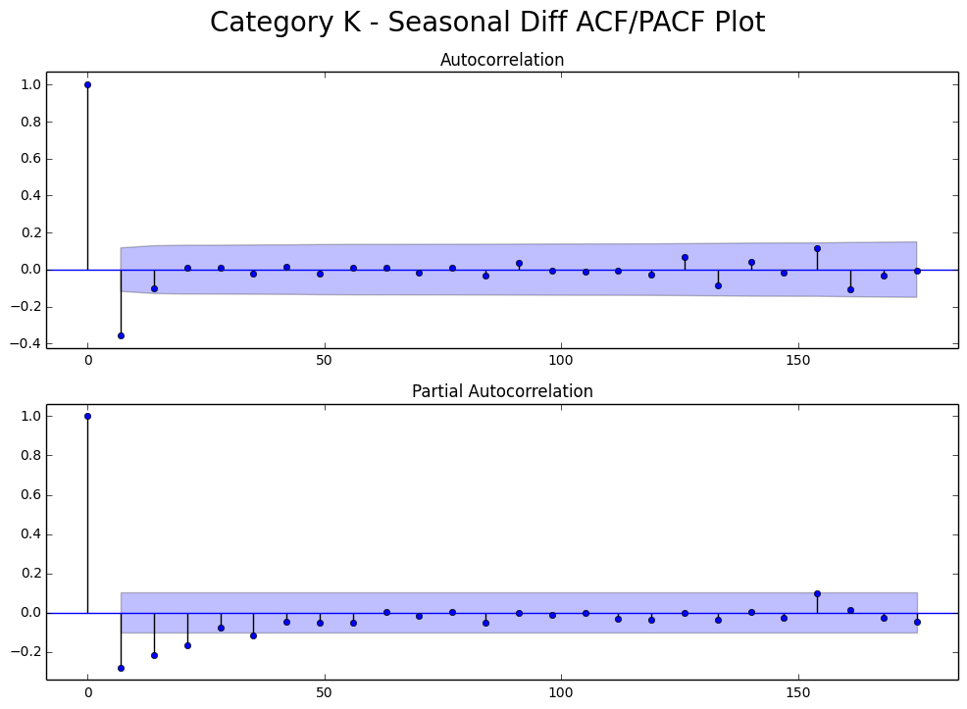
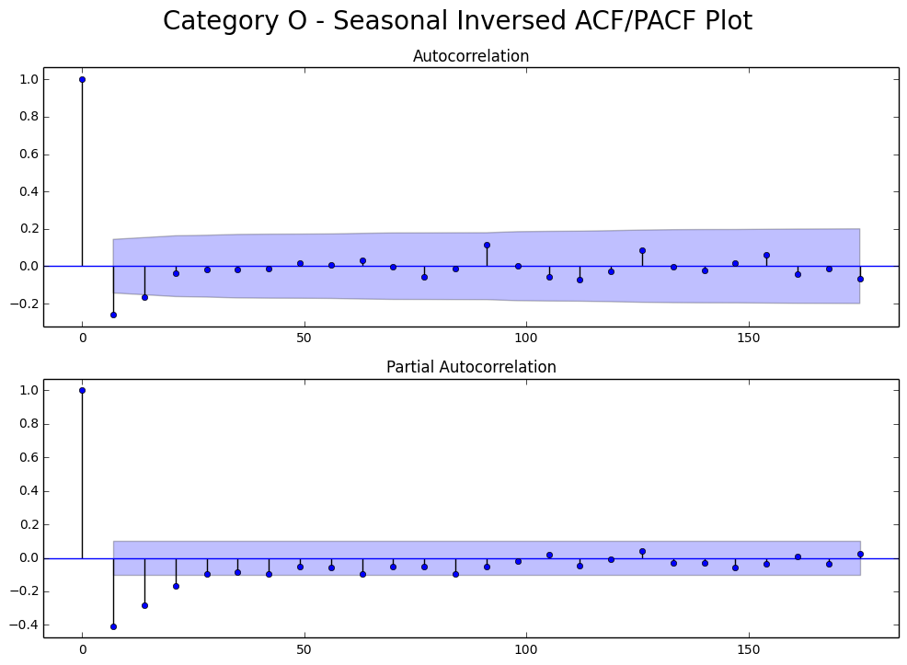
Statistical Testing – ACF/PACF Plots
ACF cut at 2 -> MA(3)
Clear cut off -> MA(2)

Slide 24
Outline
Data Cleaning
Data Exploratory
Time Series Model
Statistical Testing
ACF/PACF plots
Model Building
Forecasting
Tree Based Model
Tree Algorithm Review
Feature Engineering
Parameter Tuning
Forecast

Slide 25
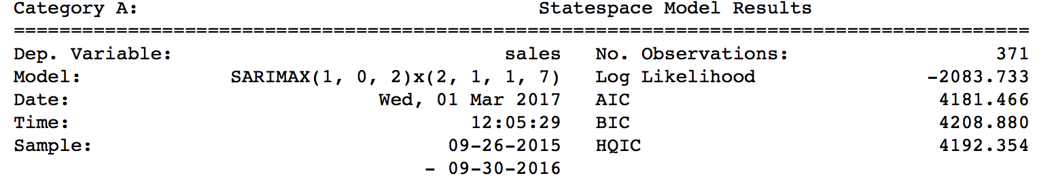
Model Building – Summary Output
Seasonal(obs)
Seasonal(Inversed( ))
Seasonal(Diff( ))
Seasonal(Diff(Inversed( )))
p
q
P
Q

Slide 26
Outline
Data Cleaning
Data Exploratory
Time Series Model
Statistical Testing
ACF/PACF plots
Model Building
Forecasting
Tree Based Model
Tree Algorithm Review
Feature Engineering
Parameter Tuning
Forecast

Slide 27
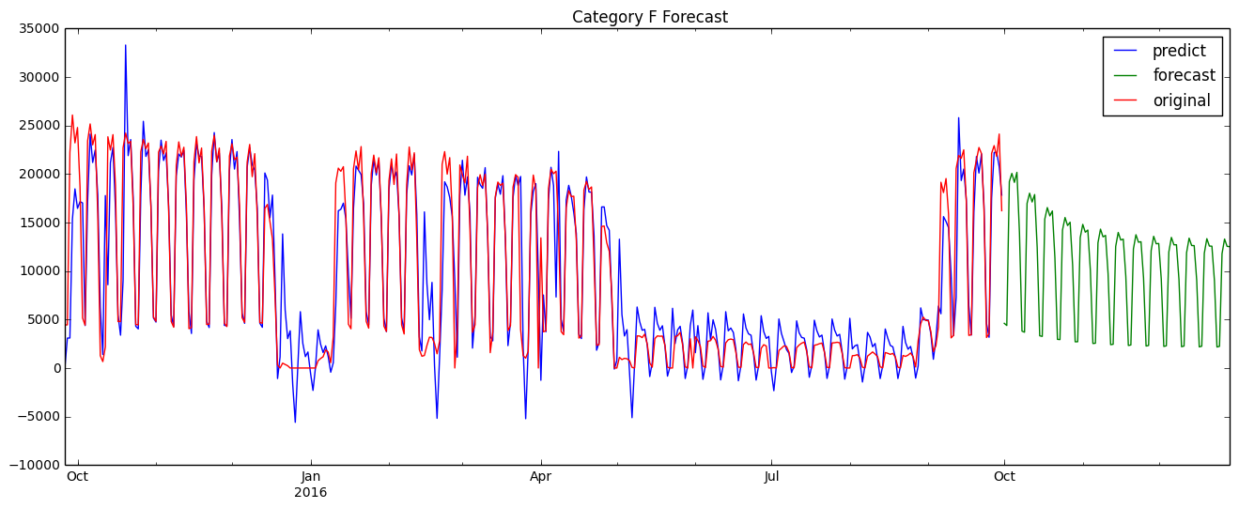
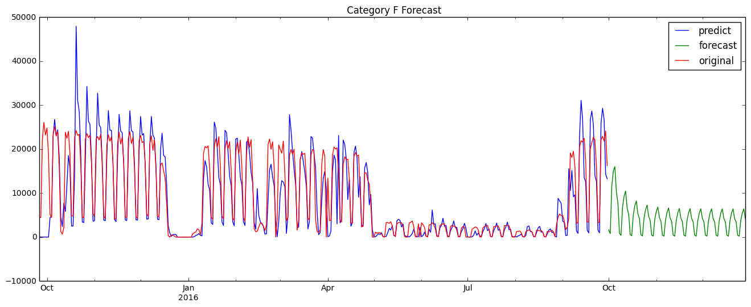
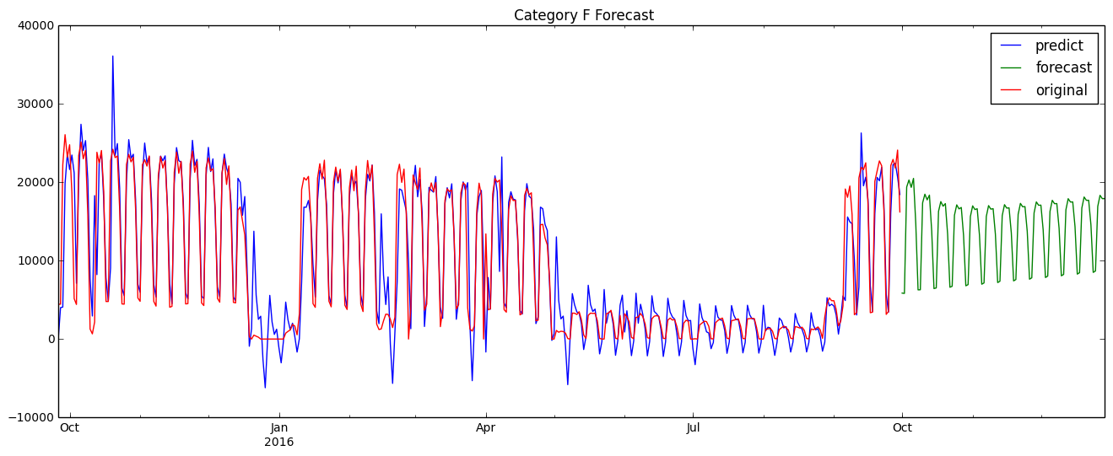
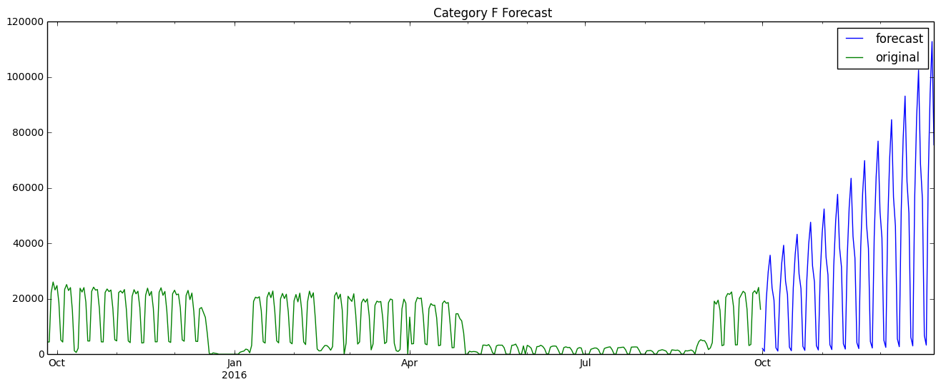
Forecasting (Category F) – Compare Models
Season(Obs)
Season(Inv)
Season(Diff)
Season(Diff(Inv))

Slide 28
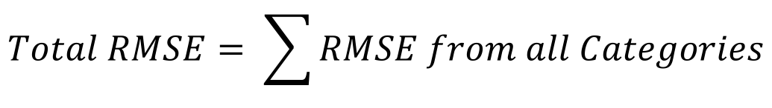
Forecasting – RMSE
$$Total RMSE= \sum{RMSE from all Categories}$$
 | Sea() | Sea(Inv) | Sea(Diff) | Sea(Diff(Inv))
Total In-Sample RMSE | 17,222 | 22,448 | 17,051 | 228,504

Slide 29
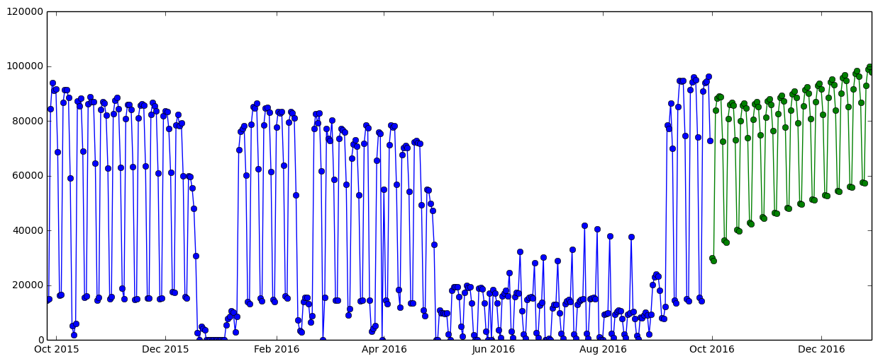
Forecasting (Site A) – Final Solution
A), B), E), H), N) – (1, 1, 1)x(2, 1, 1, 7)
C), M) – (2, 1, 1)x(1, 1, 1, 7)
D), F), G), I), K), L), O) – (1, 1, 1)x(1, 1, 1, 7)
P) – (0, 1, 2)x(1, 1, 1, 7)
Q) – (2, 1, 2)x(2, 1, 1, 7)
 | Sea() | Sea(Inv) | Sea(Diff) | Sea(Diff(Inv))
In Sample RMSE | 17,222 | 22,448 | 17,051 | 228,504
Seasonal(Diff)

Slide 30
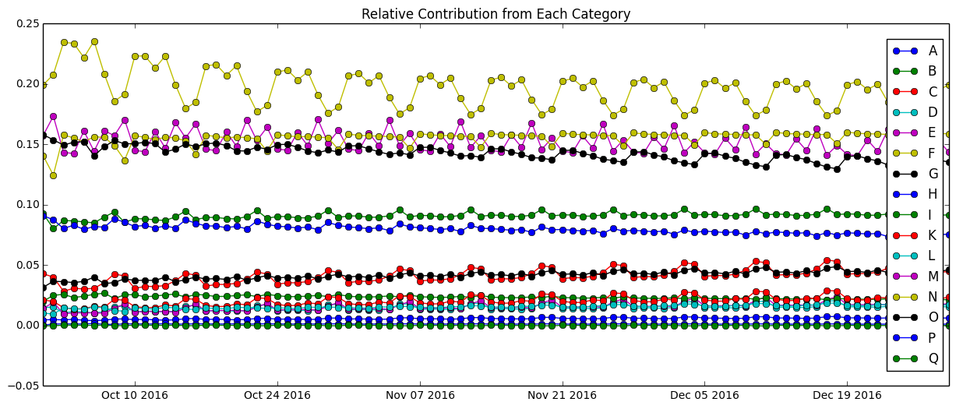
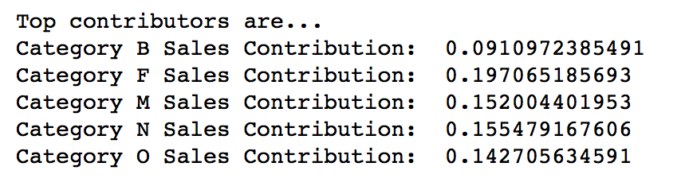
Forecasting (Site A) – Relative Contribution

Slide 31
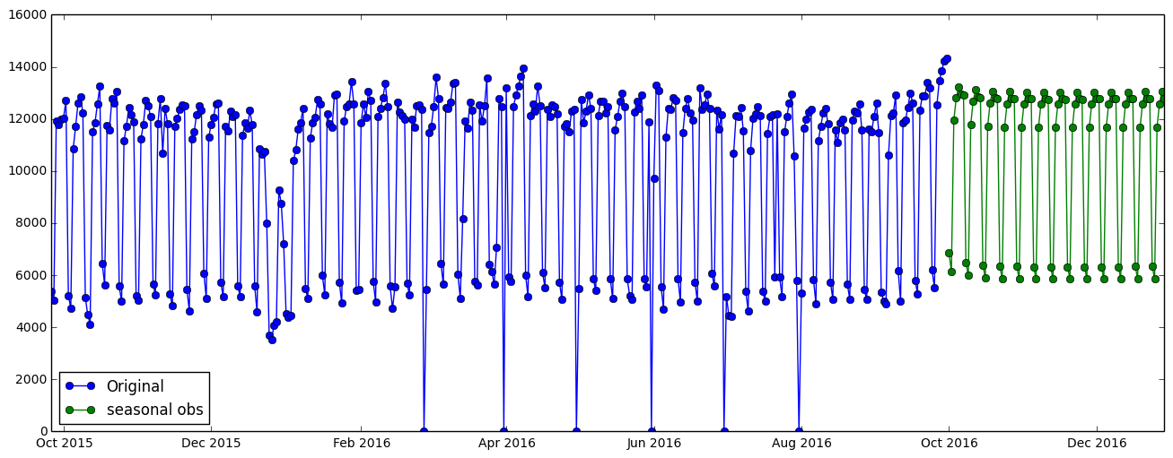
Forecasting (Site B) – Final Solution
A), B), I), M), N), O) (1, 0, 2)x(0, 1, 1, 7)
C) (1, 0, 0)x(0, 1, 1, 7)
D), L) (2, 0, 2)x(1, 1, 1, 7)
E) (1, 0, 2)x(2, 1, 1, 7)
F) (2, 0, 2)x(0, 1, 2, 7)
G), H) (2, 0, 0)x(0, 1, 1, 7)
K) (0, 0, 1)x(0, 1, 1, 7)
Q) (1, 0, 2)x(1, 1, 1, 7)
 | Season(Obs) | Season(Inv)
Total RMSE | 2514.16 | 2887.88
Seasonal(Obs)

Slide 32
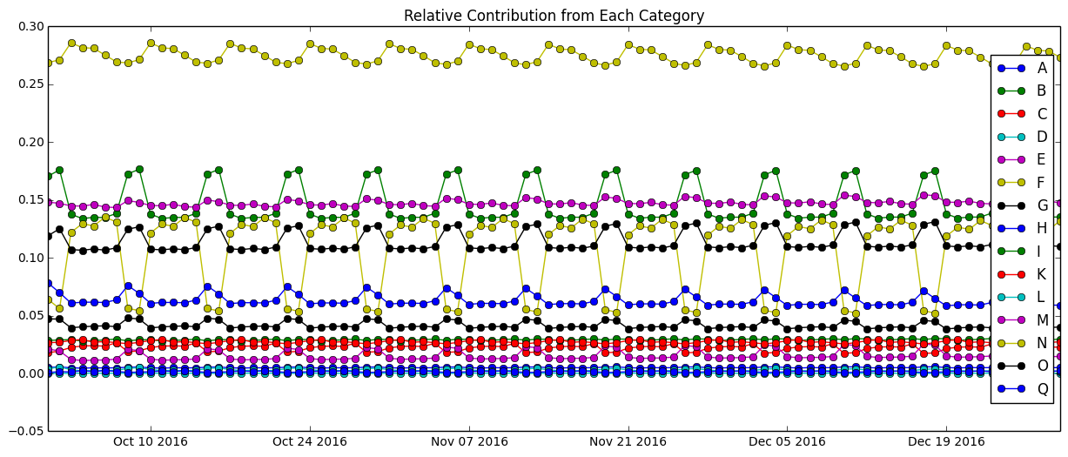
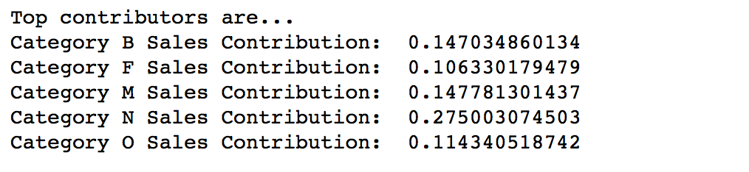
Forecasting (Site B) – Relative Contribution

Slide 33
Outline
Data Cleaning
Data Exploratory
Time Series Model
Statistical Testing
ACF/PACF plots
Model Building
Forecasting
Tree Based Model
Tree Algorithm Review
Feature Engineering
Parameter Tuning
Forecast

Slide 34
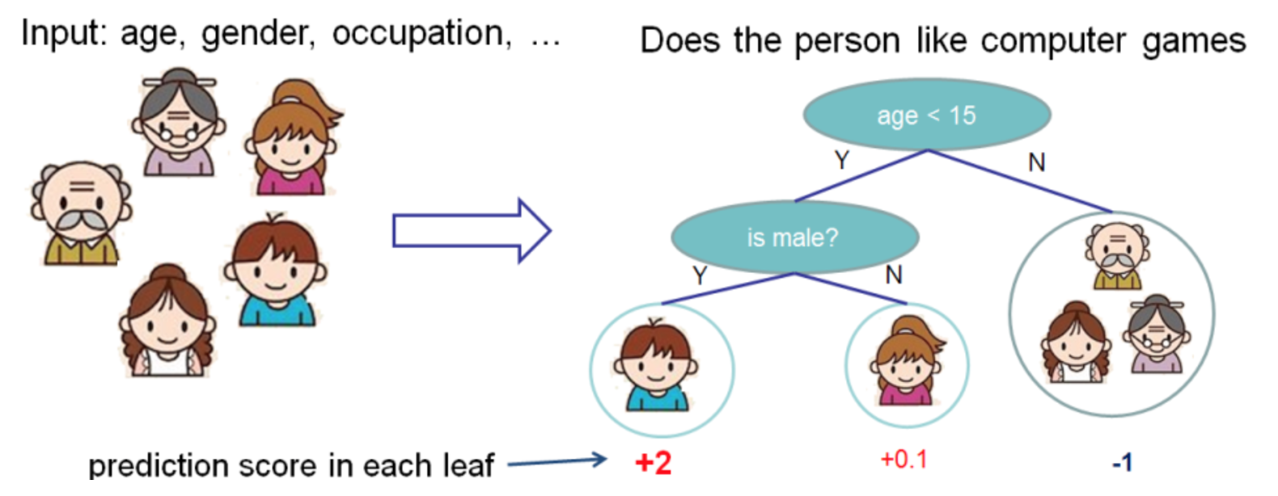
Gradient Boosting
Tree based model
Non-parametric:
we don’t assume the data to be mean zero constant variance

Slide 35
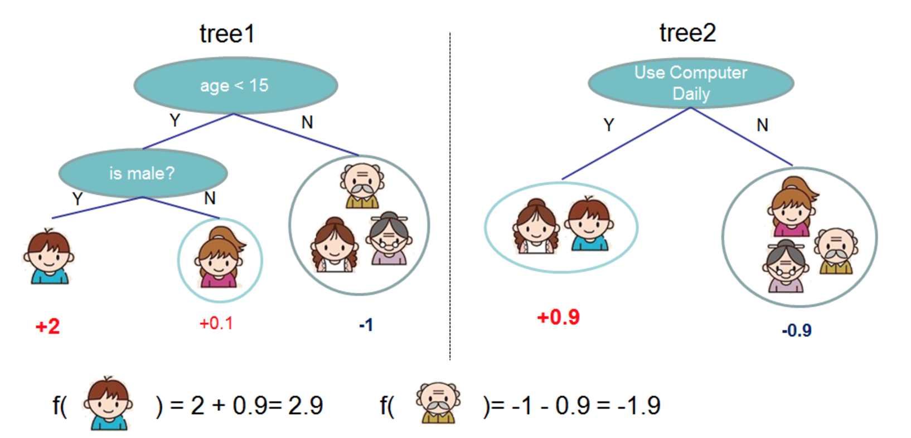
Gradient Boosting – Review

Slide 36
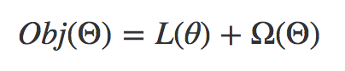
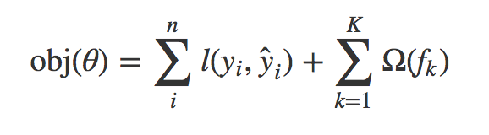
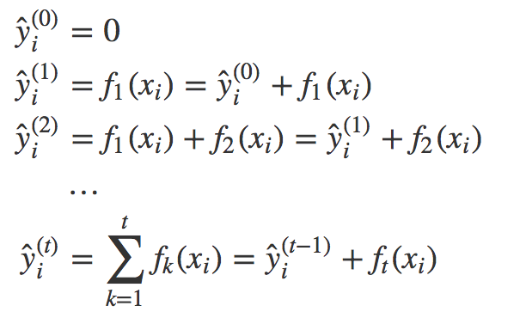
Gradient Boosting – Review
Sequentially Additive

Slide 37
Outline
Data Cleaning
Data Exploratory
Time Series Model
Statistical Testing
ACF/PACF plots
Model Building
Forecasting
Tree Based Model
Tree Algorithm Review
Feature Engineering
Parameter Tuning
Forecast

Slide 38
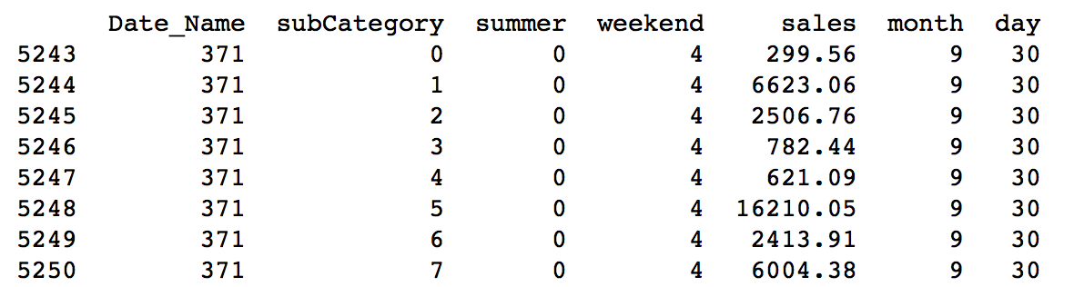
Improvement – Feature Engineering
Encoding categories
Date becomes sequence
Extracted Day
Summer or not
Extracted Month
Day of week

Slide 39
Outline
Data Cleaning
Data Exploratory
Time Series Model
Statistical Testing
ACF/PACF plots
Model Building
Forecasting
Tree Based Model
Tree Algorithm Review
Feature Engineering
Parameter Tuning
Forecast

Slide 40
Model Tuning
Guess a reasonable initial learning rate and a number of estimators
Tuning max_depth and min_child_weight
Tuning gamma to reduce overfitting
Tuning subsample and colsample_bytree
Reducing learning rate, and adding more estimators

Slide 41
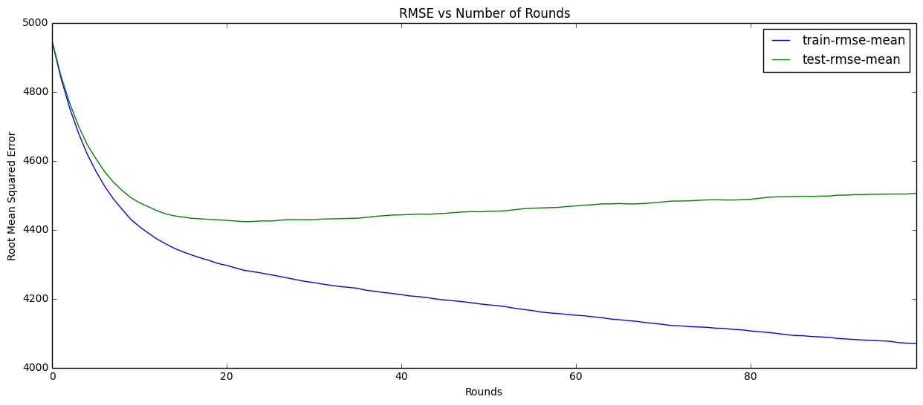
Initial Learning Rate and Number of Rounds
Learning Rate | Max Depth | Min Child Weight | Num of Rounds | Subsample | Colsample
0.1 | 5 | 3 | 100 | 0.5 | 0.5

Slide 42
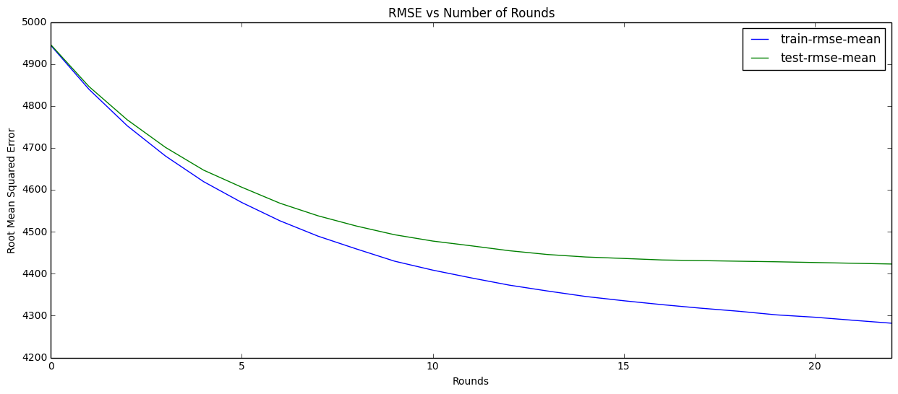
Early Stopping – Number of Rounds = 22
RMSE = 4281

Slide 43
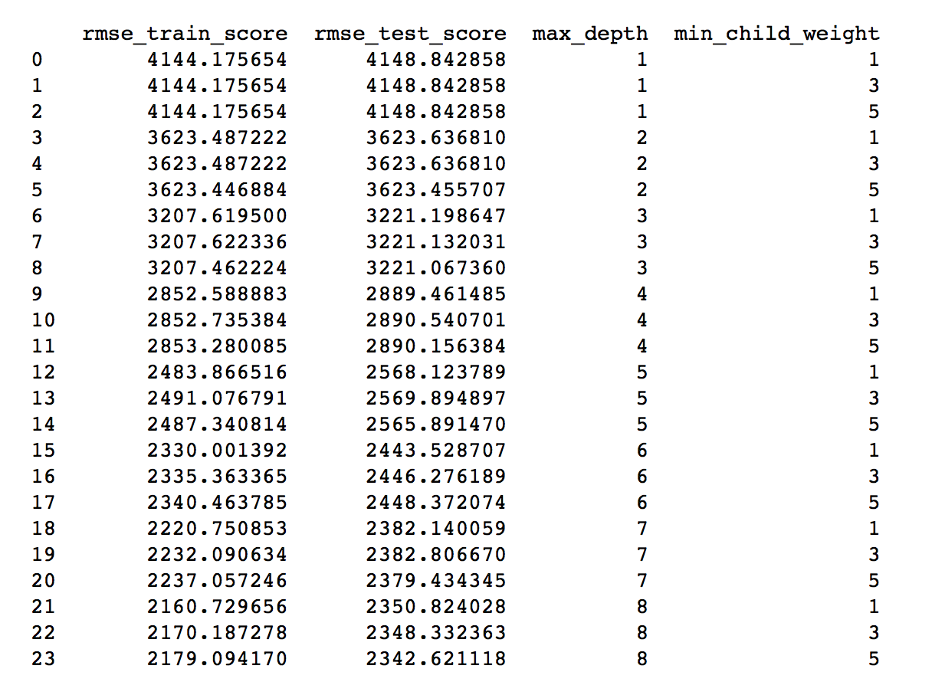
Tuning max_depth and min_child_weight

Slide 44
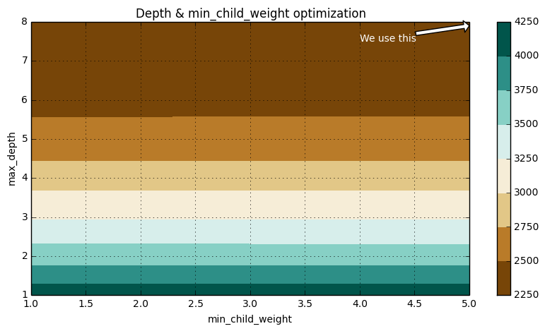
Tuning max_depth and min_child_weight
RMSE = 2343
Learning Rate | Max Depth | Min Child Weight | Num of Rounds | Subsample | Colsample
0.1 | 5 8 | 3 5 | 100 | 0.5 | 0.5

Slide 45
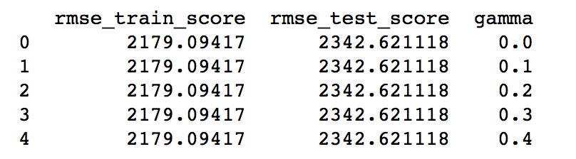
Tuning Gamma – No Effect
RMSE = 2343

Slide 46
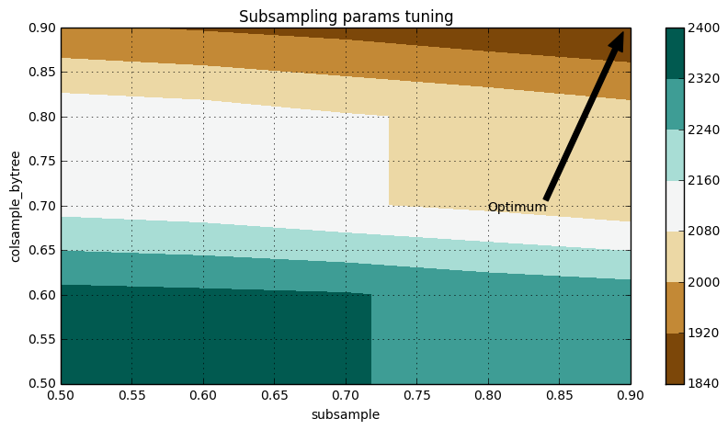
Tuning subsample and colsample_bytree
RMSE = 1846
Learning Rate | Max Depth | Min Child Weight | Num of Rounds | Subsample | Colsample
0.1 | 5 8 | 3 5 | 100 | 0.5 0.9 | 0.5 0.9

Slide 47
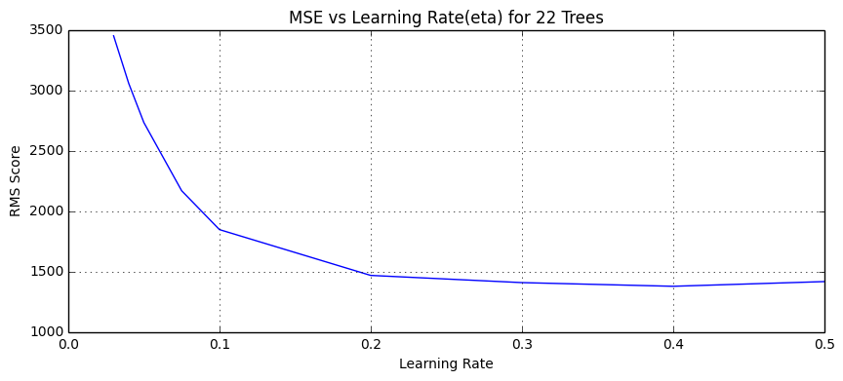
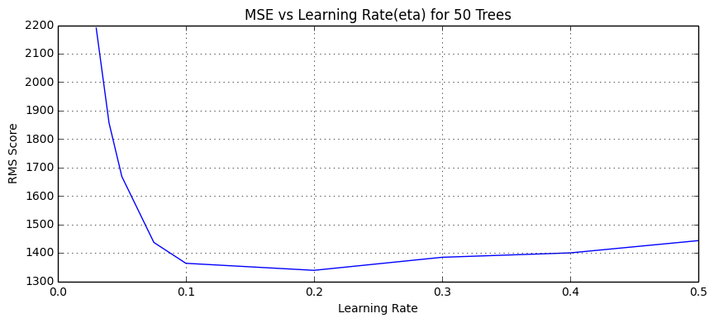
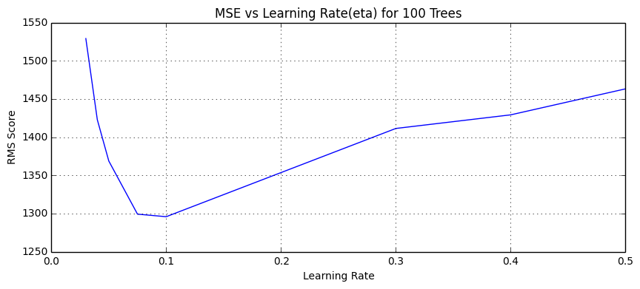
Learning Rate vs Number of Trees
RMSE = 1296

Slide 48
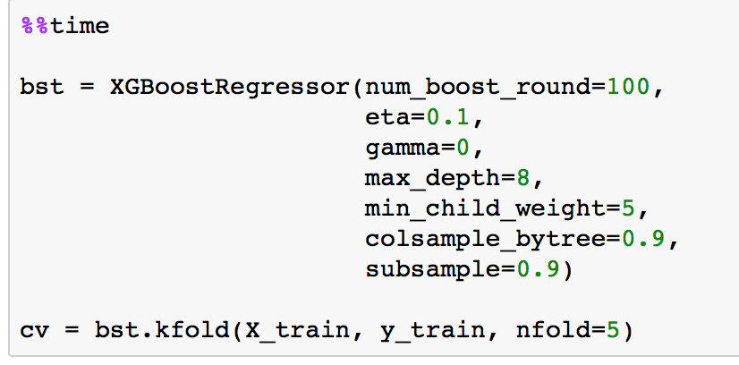
Final Model
RMSE = 1296

Slide 49
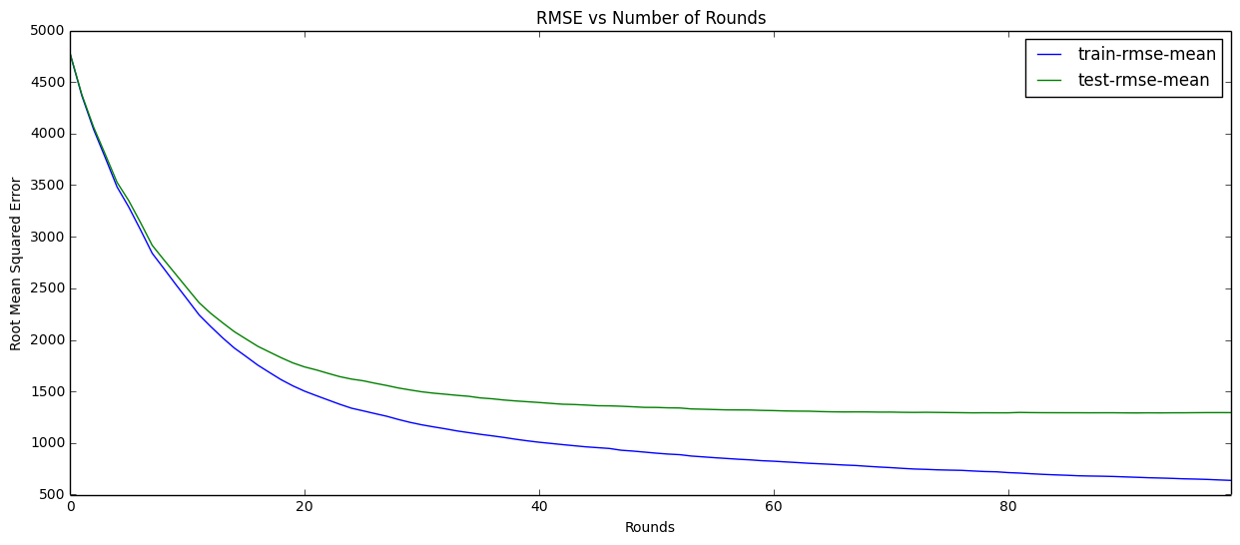
Final Model
After tuned: No overfitting
Overfitting

Slide 50
Outline
Data Cleaning
Data Exploratory
Time Series Model
Statistical Testing
ACF/PACF plots
Model Building
Forecasting
Tree Based Model
Tree Algorithm Review
Feature Engineering
Parameter Tuning
Forecast

Slide 51
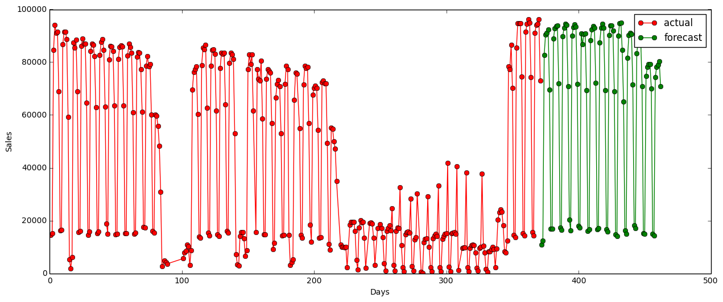
6) In Sample RMSE Comparison
 | Sea() | Sea(Diff) | XGBoost (Before) | XGBoost (After)
Total In-Sample RMSE | 17,222 | 17,051 | 4,281 | 2,865

Slide 52

Thank you! Questions?

Slide 53
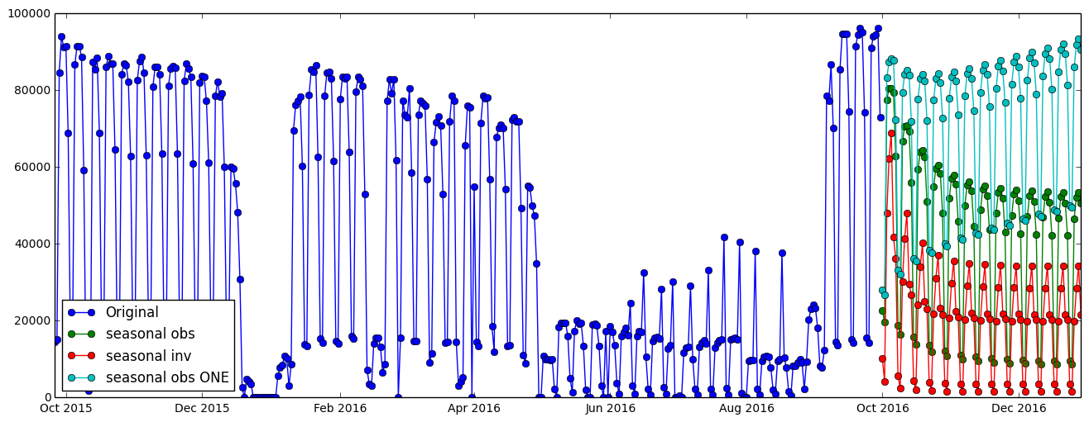
6) Improvement – Next Steps
Merge 2 SARIMA models
Stack XGBoost with SARIMA model

